Slide 1
Refinement parameters
What are the parameters to be determined?
atom positional parameters
atom thermal motion parameters
atom site occupancy parameters
background function parameters
peak shape parameters
unit cell dimensions
scale factor(s)
sample displacement, sample transparency,
zero-shift errors
preferred orientation, absorption, porosity,
extinction parameters

Slide 2
Peak shift parameters
2θ_{obs} = 2θ_{calc} + Δ2θ
where
Δ2θ = p₁/tan 2θ + p₂/sin 2θ + p₃/tan θ + p₄ sin 2θ +
p₅ cos θ + p₆

Slide 3
Peak shift parameters
2θ_{obs} = 2θ_{calc} + Δ2θ
where
Δ2θ = p₁/tan 2θ + p₂/sin 2θ + p₃/tan θ + p₄ sin 2θ +
p₅ cos θ + p₆
axial divergence

Slide 4
Peak shift parameters
2θ_{obs} = 2θ_{calc} + Δ2θ
where
Δ2θ = p₁/tan 2θ + p₂/sin 2θ + p₃/tan θ + p₄ sin 2θ +
p₅ cos θ + p₆
axial divergence
p₁ = –h² K₁/3R R = diffractometer radius
p₂ = –h² K₂/3R K₁, K₂ = constants for collimator
h = specimen width

Slide 5
Peak shift parameters
2θ_{obs} = 2θ_{calc} + Δ2θ
where
Δ2θ = p₁/tan 2θ + p₂/sin 2θ + p₃/tan θ + p₄ sin 2θ +
p₅ cos θ + p₆
 flat sample

Slide 6
Peak shift parameters
2θ_{obs} = 2θ_{calc} + Δ2θ
where
Δ2θ = p₁/tan 2θ + p₂/sin 2θ + p₃/tan θ + p₄ sin 2θ +
p₅ cos θ + p₆
 flat sample
p₃ = – α²/K₃ α = beam divergence
K₃ = constant

Slide 7
Peak shift parameters
2θ_{obs} = 2θ_{calc} + Δ2θ
where
Δ2θ = p₁/tan 2θ + p₂/sin 2θ + p₃/tan θ + p₄ sin 2θ +
p₅ cos θ + p₆
 specimen transparency

Slide 8
Peak shift parameters
2θ_{obs} = 2θ_{calc} + Δ2θ
where
Δ2θ = p₁/tan 2θ + p₂/sin 2θ + p₃/tan θ + p₄ sin 2θ +
p₅ cos θ + p₆
 specimen transparency
p₄ = 1/2μ_{eff}R
μ_{eff} = effective linear absorption coefficient

Slide 9
Peak shift parameters
2θ_{obs} = 2θ_{calc} + Δ2θ
where
Δ2θ = p₁/tan 2θ + p₂/sin 2θ + p₃/tan θ + p₄ sin 2θ +
p₅ cos θ + p₆
specimen displacement
p₅ = –2s/R
s = displacement

Slide 10
Peak shift parameters
2θ_{obs} = 2θ_{calc} + Δ2θ
where
Δ2θ = p₁/tan 2θ + p₂/sin 2θ + p₃/tan θ + p₄ sin 2θ +
p₅ cos θ + p₆
zero error

Slide 11
Peak shift parameters
2θ_{obs} = 2θ_{calc} + Δ2θ
where
Δ2θ = p₁/tan 2θ + p₂/sin 2θ + p₃/tan θ + p₄ sin 2θ +
p₅ cos θ + p₆
p₄, p₅, & p₆ strongly correlated when refined together

Slide 12
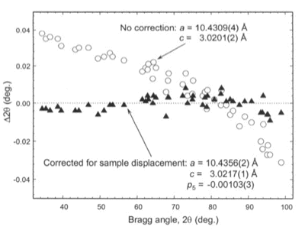
Peak shift parameters
2θ_{obs} = 2θ_{calc} + Δ2θ
where
Δ2θ = p₁/tan 2θ + p₂/sin 2θ + p₃/tan θ + p₄ sin 2θ +
p₅ cos θ + p₆
p₄, p₅, & p₆ strongly correlated when refined together
When instrument correctly
aligned, generally need get
only p₅

Slide 13



Peak shift parameters
Δ2θ = p₁/tan 2θ + p₂/sin 2θ + p₃/tan θ + p₄ sin 2θ +
p₅ cos θ + p₆
In GSAS:
where:

Slide 14
Preferred orientation
In powder diffractometry, usually assume random orientation
For this, need >10⁶ randomly oriented particles

Slide 15
Preferred orientation
In powder diffractometry, usually assume random orientation
For this, need >10⁶ randomly oriented particles
Extremes: diffraction vector
plates
needles
diffraction vector normal
cylindrical symmetry

Slide 16
Preferred orientation
In powder diffractometry, usually assume random orientation
For this, need >10⁶ randomly oriented particles
Extremes: diffraction vector
plates
needles
diffraction vector normal
cylindrical symmetry
S = s - s_{o}
s_{o}
s

Slide 17
Preferred orientation
In powder diffractometry, usually assume random orientation
For this, need >10⁶ randomly oriented particles
Extremes: diffraction vector
plates
needles
diffraction vector normal
cylindrical symmetry

Slide 18


Preferred orientation
March-Dollase function (a la GSAS)
plates
needles

Slide 19
Preferred orientation
March-Dollase function (a la GSAS)
plates
needles
multiplier in intensity equation
# symmetrically equivalent reflections

Slide 20
Preferred orientation
March-Dollase function (a la GSAS)
plates
needles
multiplier in intensity equation
# symmetrically equivalent reflections

Slide 21
Preferred orientation
March-Dollase function (a la GSAS)
plates
needles
multiplier in intensity equation
# symmetrically equivalent reflections
preferred orientation parameter
(refined)

Slide 22
Preferred orientation
March-Dollase function (a la GSAS)
plates
needles
multiplier in intensity equation
# symmetrically equivalent reflections
angle betwn orientation axis & diffraction vector for hkl
preferred orientation parameter
(refined)

Slide 23
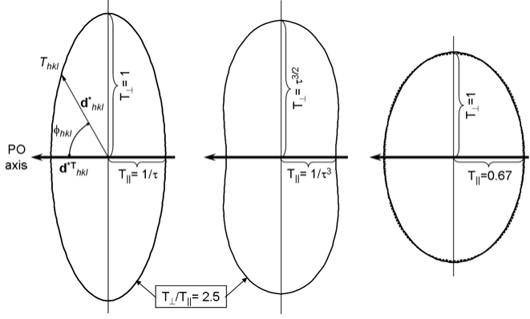
Preferred orientation
March-Dollase function (a la GSAS)

Slide 24

Preferred orientation
Spherical harmonics (a la GSAS)
hkl
sample orientation

Slide 25
Preferred orientation
Spherical harmonics (a la GSAS)
hkl
sample orientation
harmonic coefficients
harmonic functions

